Slide 1

Project Title -Seasonal Agriculture Performance Analysis
Name: Madhan R
College Name: Panimalar Engineering College
AICTE STU ID : STU6946875180e901766229841

Slide 2

PROBLEM STATEMENT
(Agricultural activities are influenced by seasonal variations in environmental conditions, farming practices, resource availability and market conditions. As a result, agricultural performance may differ from one season to another. However, raw agricultural data does not clearly explain how agricultural performance changes across seasons or what patterns can be observed in different seasonal conditions. The problem is to analyze the given agricultural dataset and investigate seasonal differences in agricultural performance by identifying meaningful patterns, trends, relationships and variations within the available data.

Slide 3
Project Description
This project performs a complete data analytics study of agricultural performance across different seasons.
The dataset contains information about:
Seasons
Crops
States and districts
Farming conditions
Environmental factors
Irrigation methods
Water usage and efficiency
Crop yield and production
Revenue and cost
Profit
Disease and pest risk
Project Workflow:
Data Collection → Data Cleaning → EDA → Seasonal Analysis → Crop Analysis → Resource Analysis → Regional Analysis → Correlation → Statistical Testing → Visualization → Insights → Recommendations

Slide 4
WHO ARE THE END USERS?
The insights generated by this project can potentially support:
🌾 Farmers
Understand seasonal crop performance
Compare irrigation methods
🏛️ Agricultural Planners
Support seasonal agricultural planning
Identify regional variations
🔬 Agricultural Researchers
Study seasonal patterns
Analyze environmental relationships
📊 Data Analysts
Analyze agricultural datasets
🎓 Students & Researchers
Learn real-world data analytics

Slide 5

Technology Used
  Programming Language
  🐍 Python
  Development Platform
  ☁️ Google Colab
  Data Analysis
  Pandas, NumPy, Data, Visualization, Matplotlib,
  Seaborn, Statistical, AnalysisSciPy, One-Way ANOVA
  Documentation
  Jupyter Notebook
  GitHub
  Dataset
  CSV — Seasonal Agriculture Performance Dataset

Slide 6
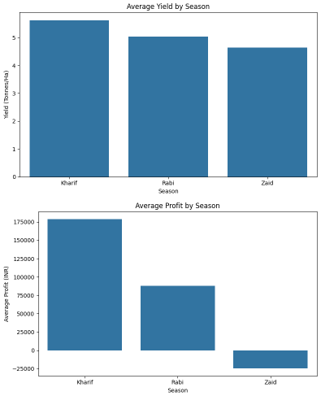
RESULTS
RESULTS
Dataset overview
• 4,000 farm records
• 28 variables
• 3 seasons: Kharif, Rabi and Zaid
• 8 crops, 8 states and 10 districts
• 4 irrigation methods
• Missing values were found in rainfall, soilmoisture and yield and handled with medianimputation.

Slide 7
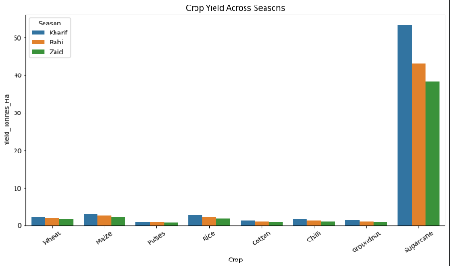
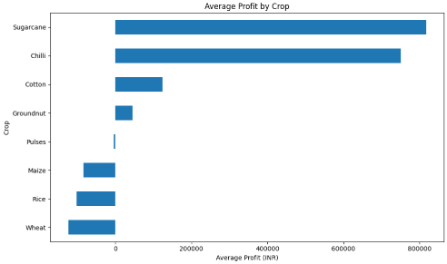
RESULTS
Agricultural performance was compared across:
States
Districts
Seasons
Analysis Performed
State-wise profit comparison
Seasonal performance by region
Regional variations
Crop and resource differences

Slide 8
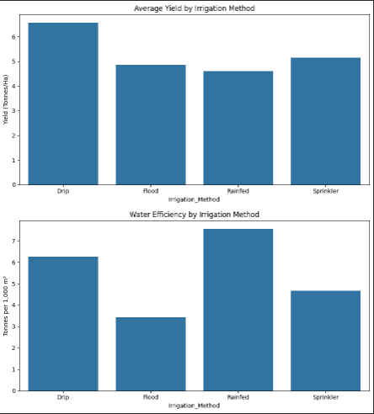
RESULTS
IRRIGATION PERFORMANCE
Different irrigation methods were compared based on:
Yield
Water usage
Water efficiency
Profit
Key Finding
💧 Drip irrigation recorded the highest average yield among the analyzed irrigation methods.
Water Efficiency
The analysis also identified a strong positive relationship between water efficiency and crop yield.
Observed correlation:
≈ 0.92

Slide 9
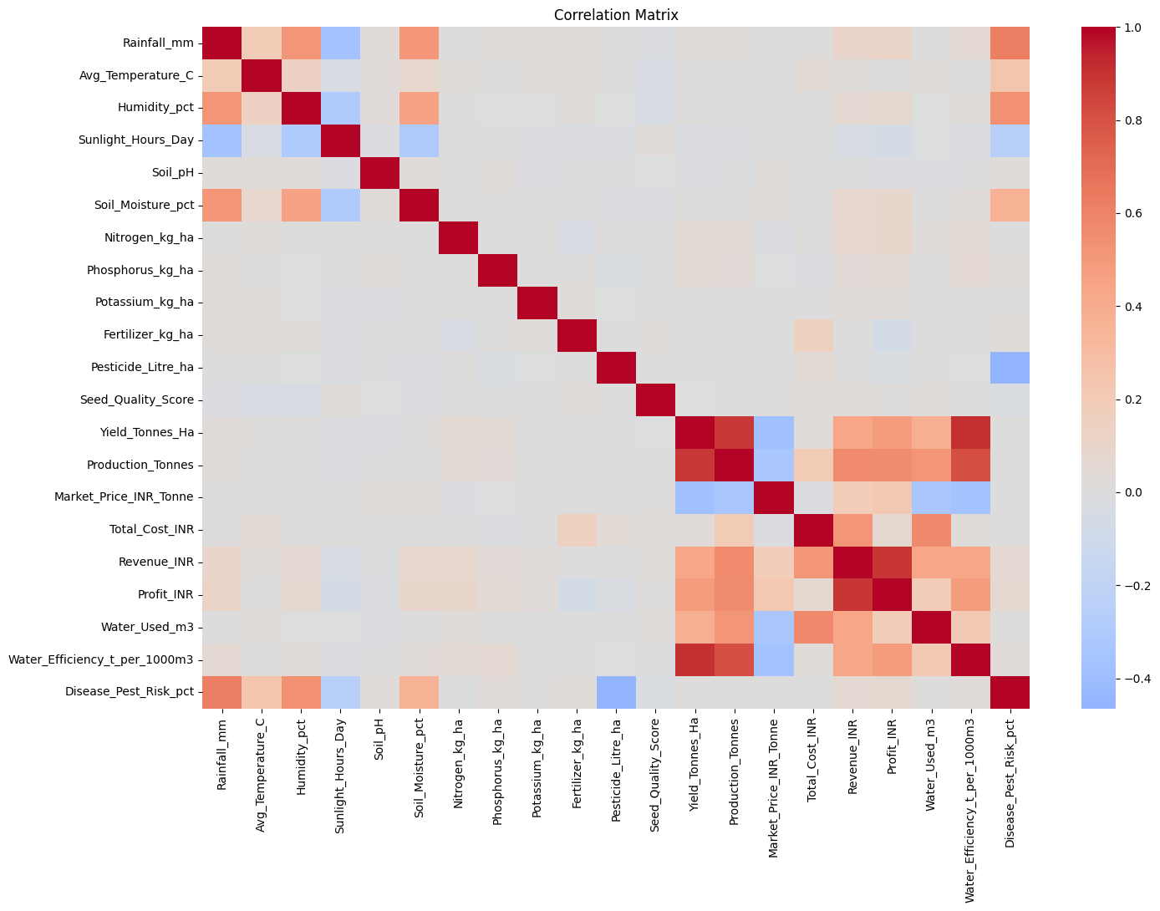
RESULTS

Slide 10
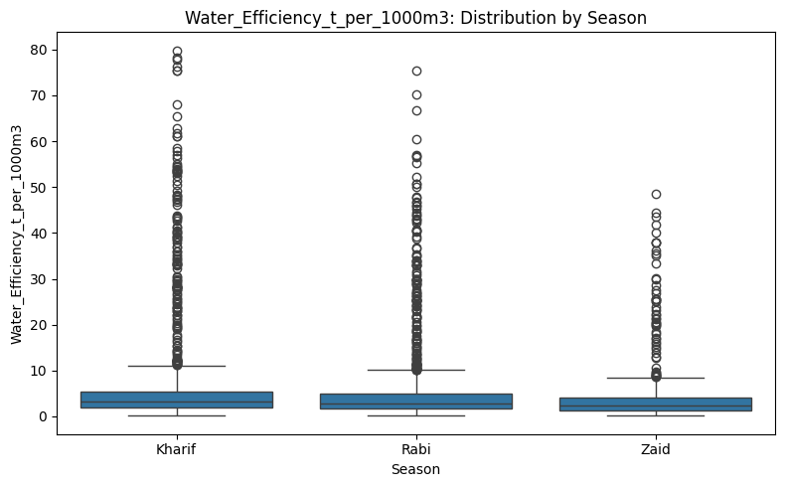
RESULTS

Slide 11
Future scope
🔮 Future Enhancements
1. Machine Learning Prediction
Predict:
Crop yield
Production
Water requirements
2. Real-Time Data
Integrate:
Weather data
Rainfall
Soil conditions
3. Interactive Dashboard
Develop dashboards using:
Streamlit
Power BI
4. Recommendation System
Recommend:
Suitable crops
Irrigation methods
5. Geographic Analysis
Use GIS/location-based analysis for detailed regional insights

Slide 12
GitHub Link
https://github.com/madhanr27/Seasonal-Agriculture-Performance-Analysis

Slide 13

VOIS Course completion certificate -
Course name- Data Visualization

Slide 14
Thank you
.
.

